Slide 1
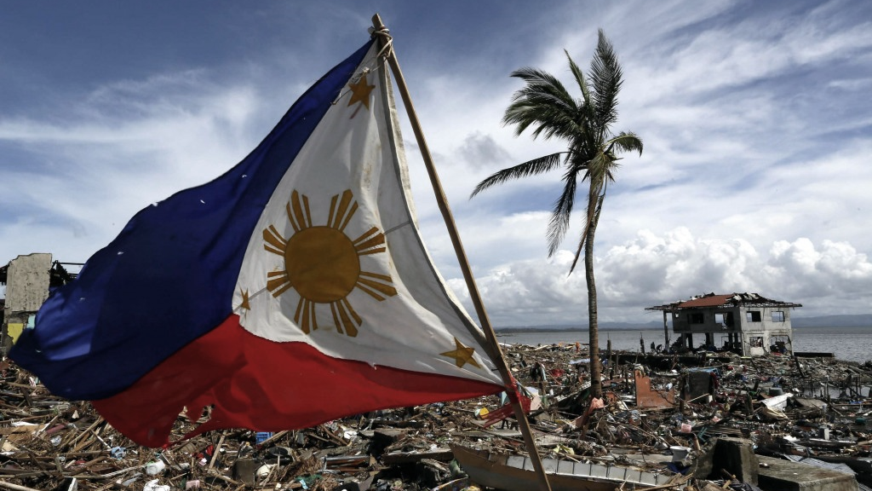



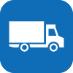

The NDRRMC-Logistics Web Application is divided into three (3)
modules, namely
Procurement
User Management
Transport
Logistics Cluster

Slide 2
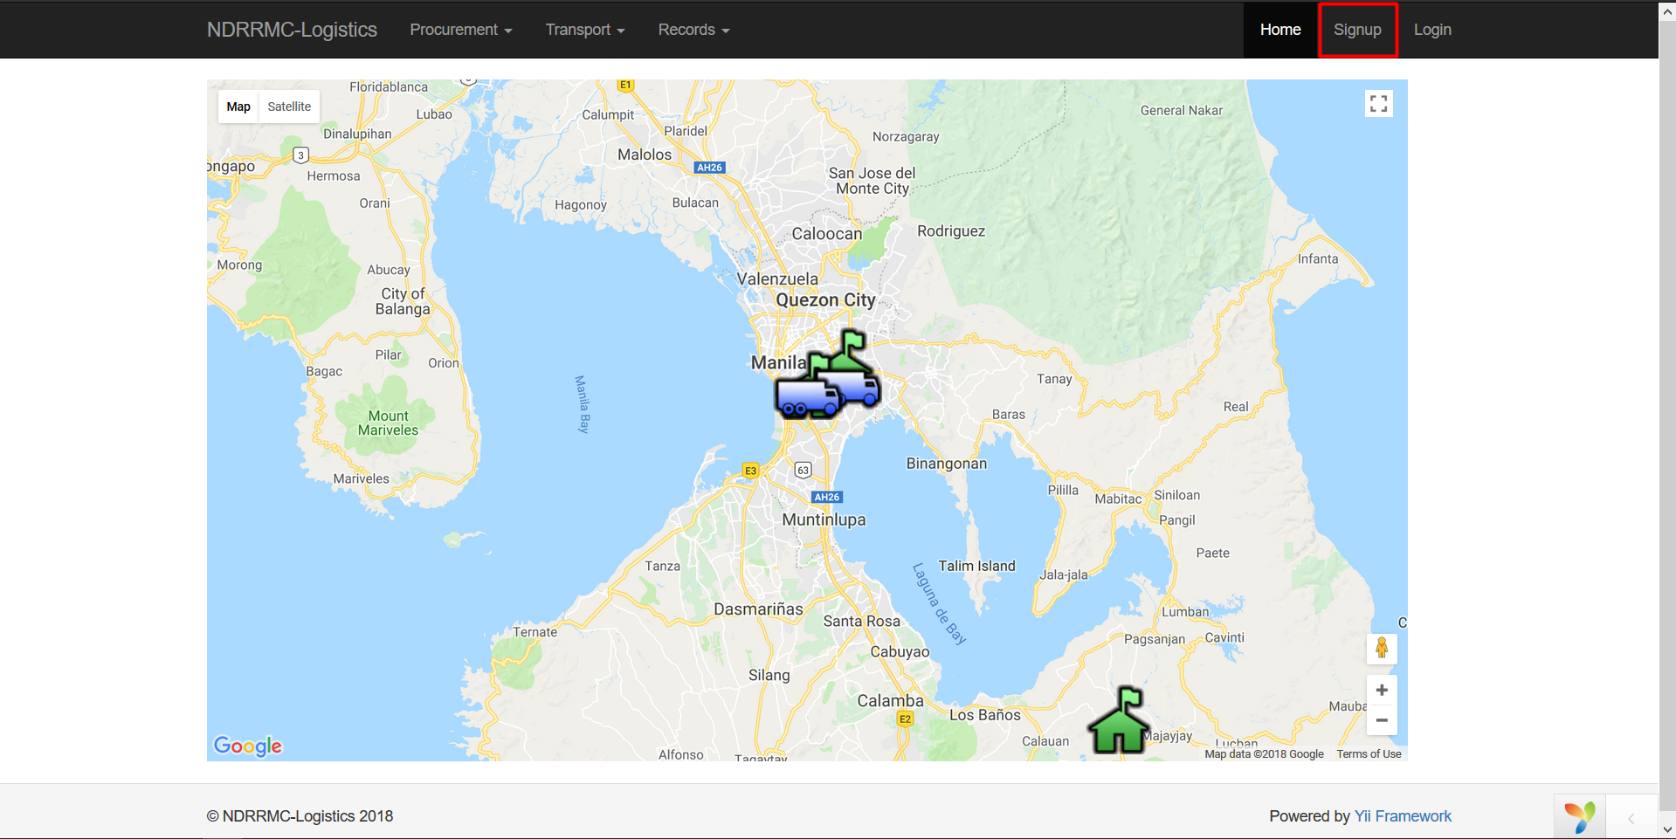
User Management
Logistics Cluster
To register a user, go to the home page and click on the signup button

Slide 3
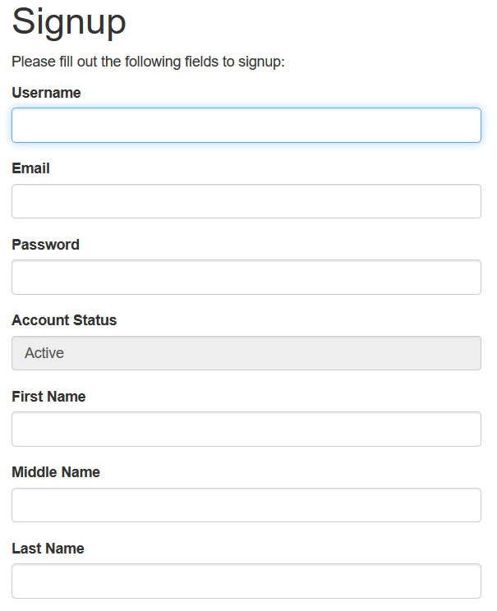
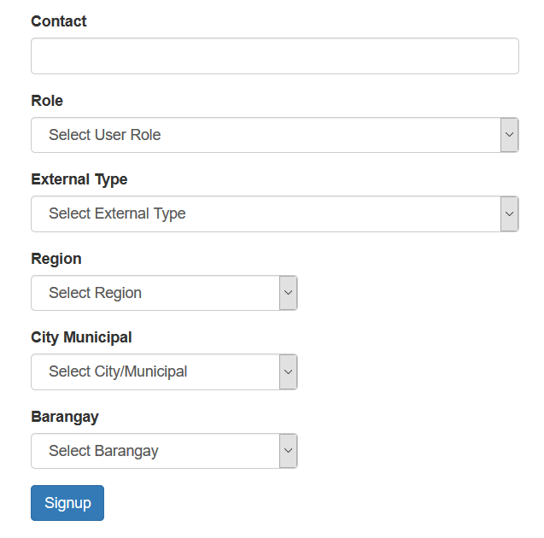
User Management
Logistics Cluster
To register a user, go to the home page and click on the signup button

Slide 4
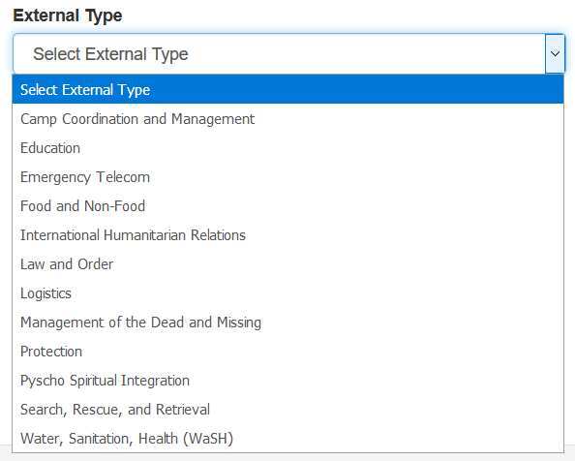
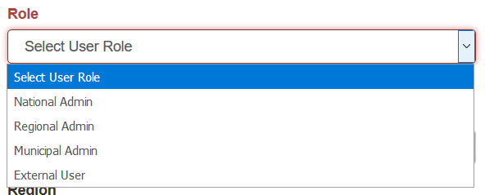
User Management
The system caters to four (4) different users, the National Admin,
Regional Admin, City/Municipal Admin, and External Users.
Logistics Cluster
External Users are then divided into the 12 cluster groups.

Slide 5
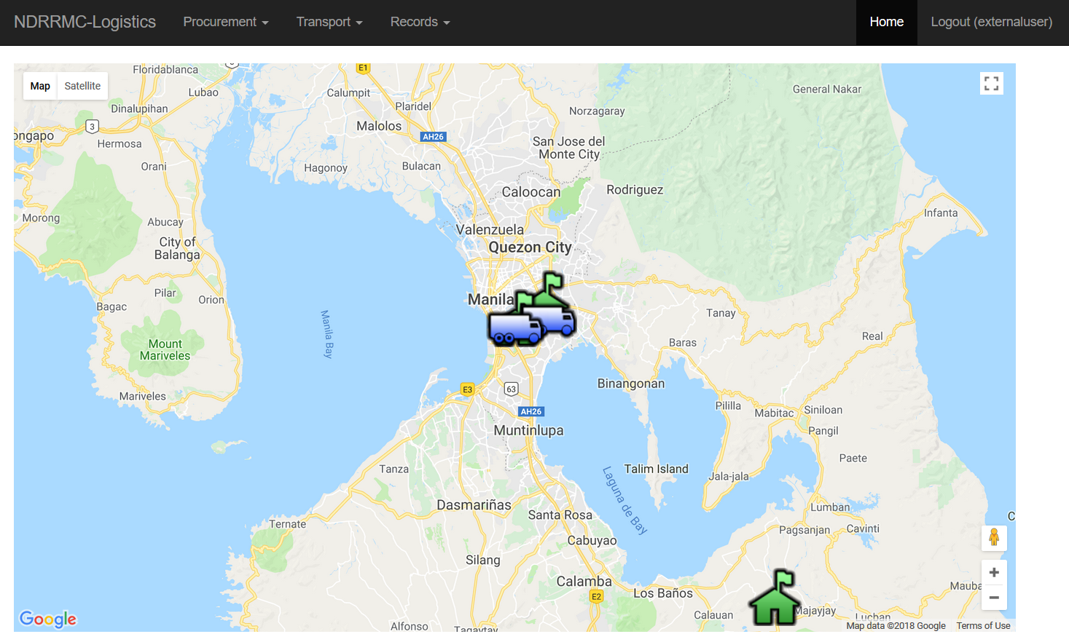
After successfully signing in, your screen will be redirected to the
homepage so you can access the different modules.
User Management
Logistics Cluster
Procurement

Slide 6




User Management
Procurement
Now, on to the Procurement Module
Procurement is the process of gathering resources. This system will
cater the following operations.
Create
View
Update
Delete
Logistics Cluster
of Suppliers, Resources, and Requests.

Slide 7
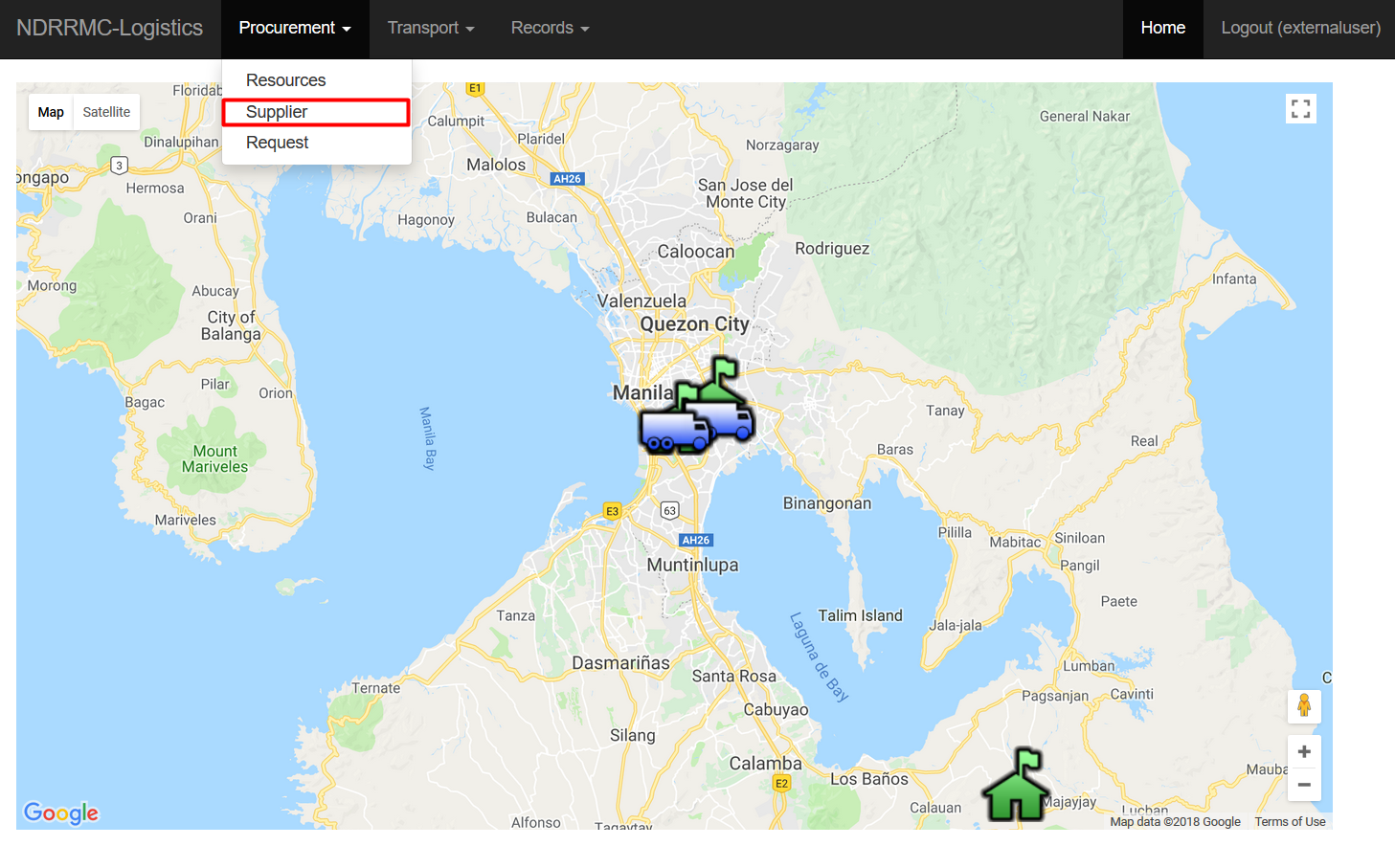
For Creating Suppliers, go to the Procurement Tab, and choose Supplier
Procurement
Logistics Cluster

Slide 8
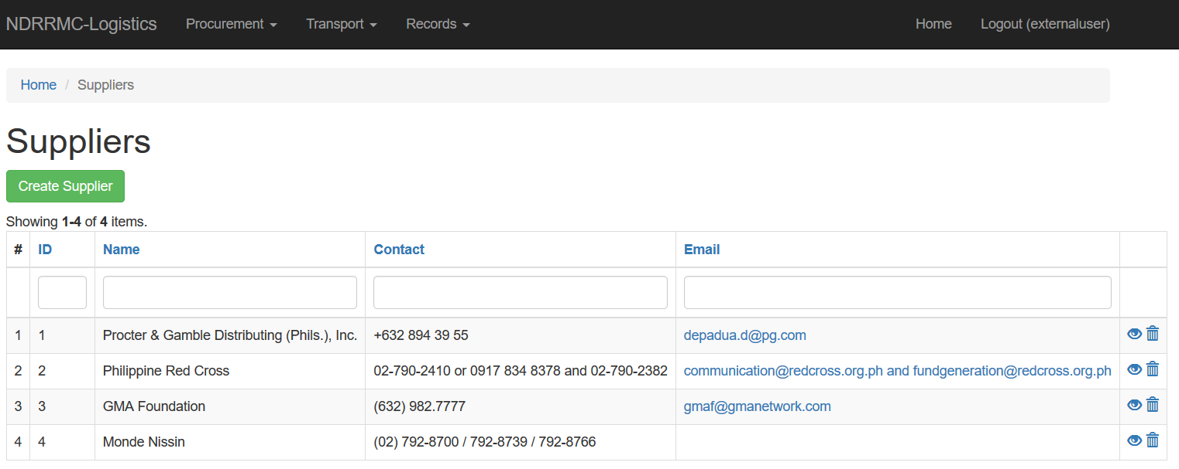
This will re-direct you to the Supplier home page
Procurement
This will display all the recorded suppliers. The user has the option
Logistics Cluster
to CREATE, VIEW, UPDATE, and DELETE suppliers.

Slide 9
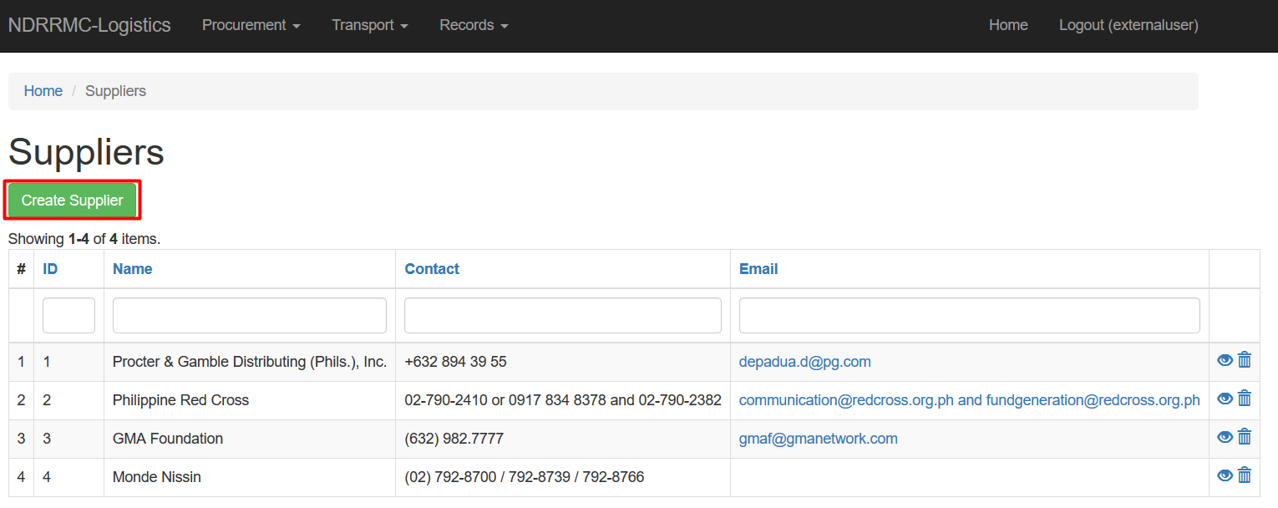
For creating suppliers, click the “Create Supplier” button.
Procurement
This will re-direct you to the web page to fill-in the required fields
Logistics Cluster
for creating a supplier.

Slide 10
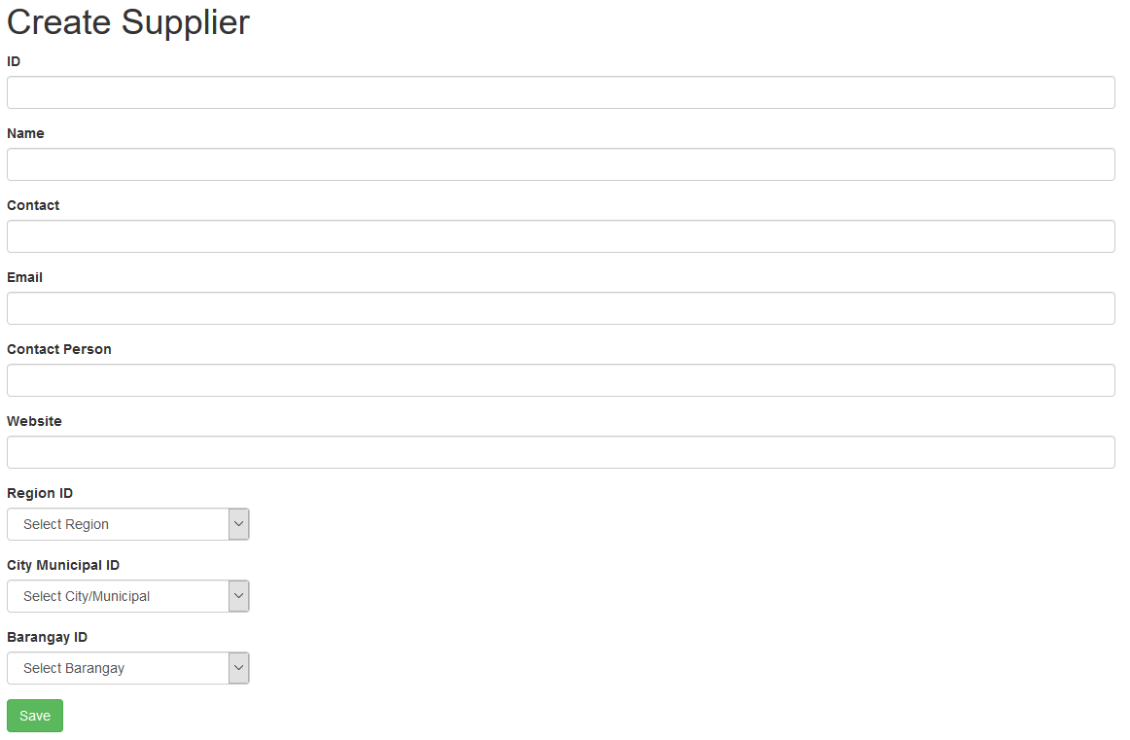
These are the fields the user has to fill-in to create a supplier.
Procurement
Logistics Cluster

Slide 11
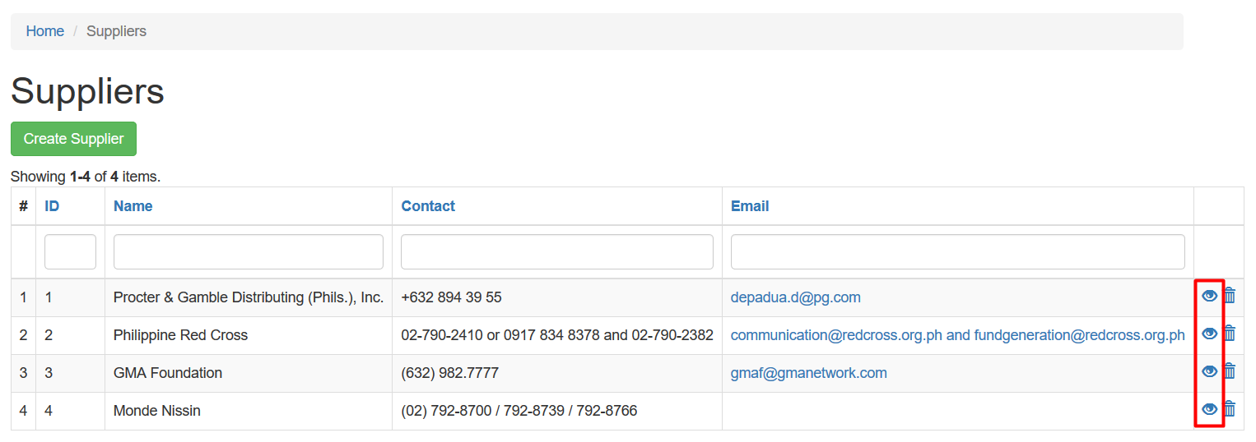
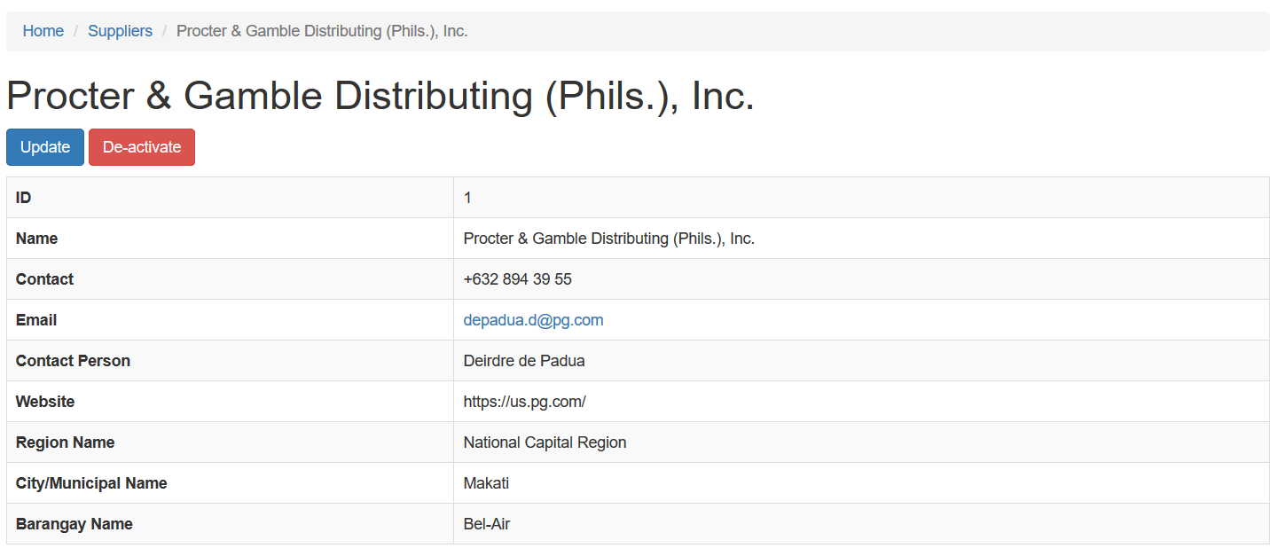
To view the users, click the EYE icon on the rightmost column
Procurement
It will then show a much more detailed view of the selected supplier
Logistics Cluster

Slide 12
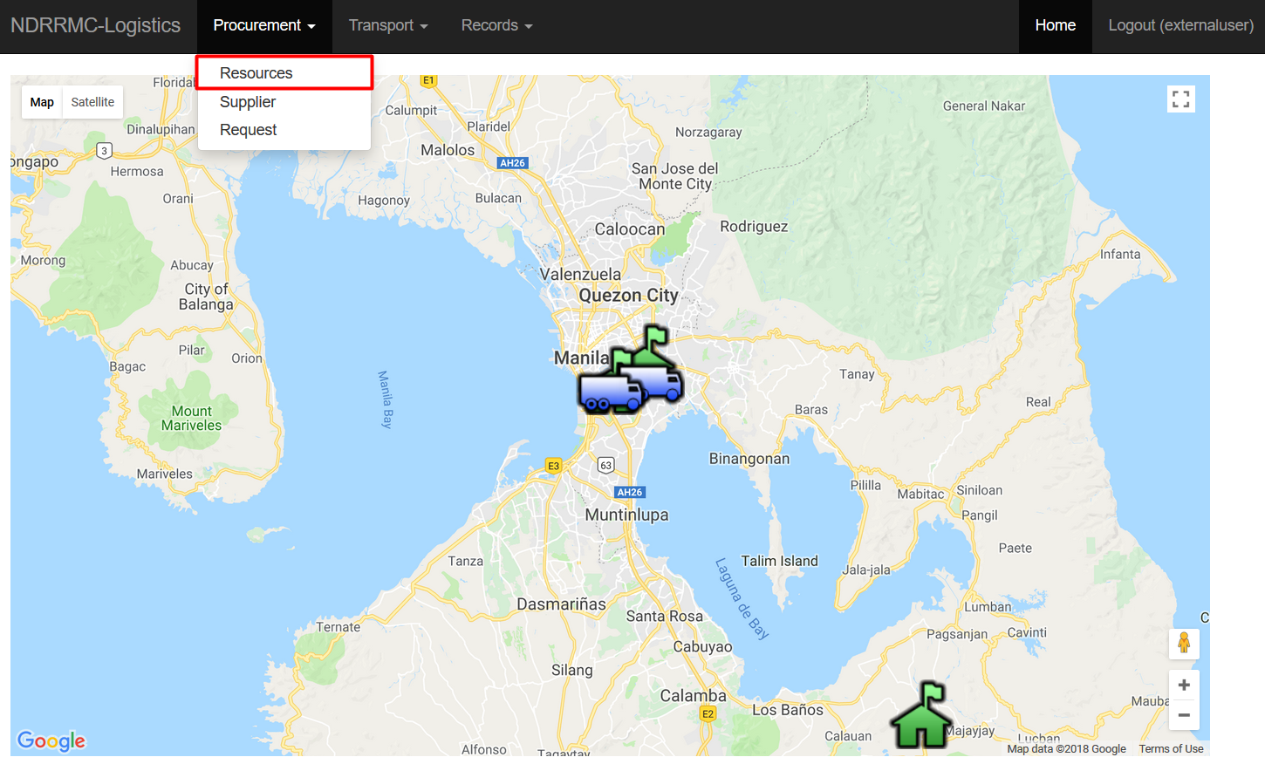
For Creating Resources, go to the Procurement Tab, and choose Resources
Procurement
Logistics Cluster

Slide 13
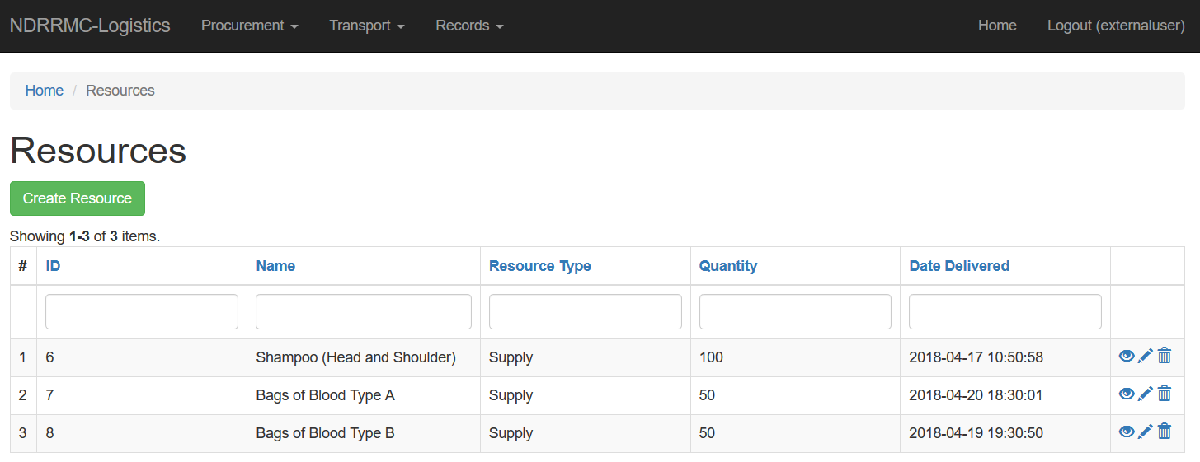
This will re-direct you to the Resources home page
Procurement
This will display all the recorded resources. The user has the option
Logistics Cluster
to CREATE, VIEW, UPDATE, and DELETE suppliers.

Slide 14
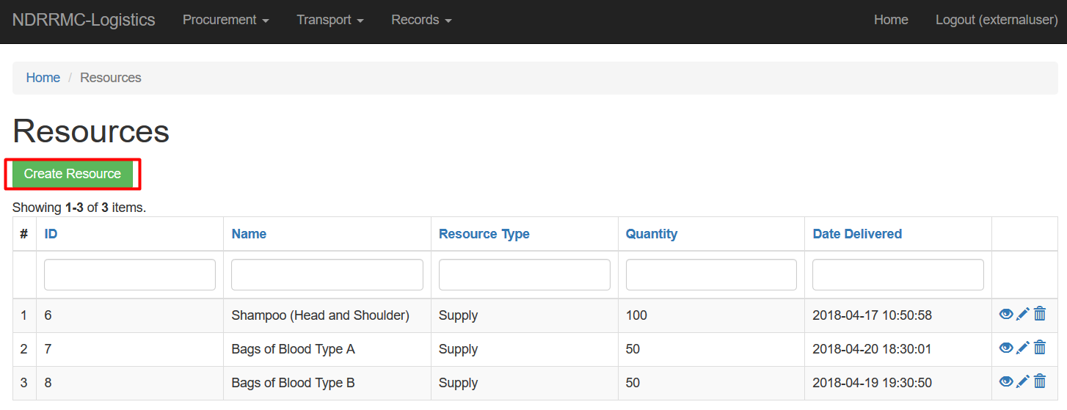
For creating resources, click the “Create Resources” button.
Procurement
This will re-direct you to the web page to fill-in the required fields
Logistics Cluster
for creating a resource.

Slide 15
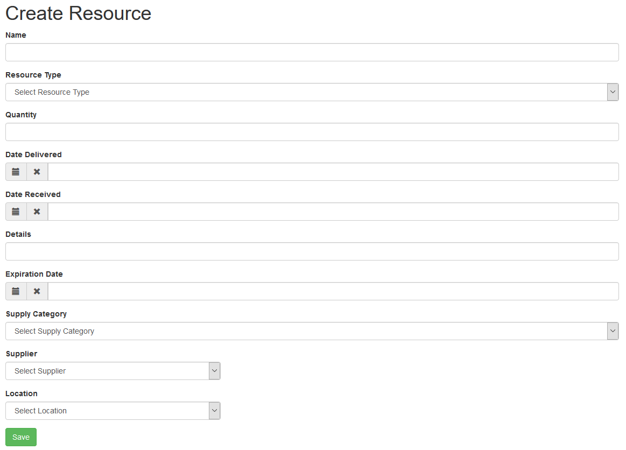
These are the fields the user has to fill-in to create a Resource.
Procurement
Logistics Cluster

Slide 16
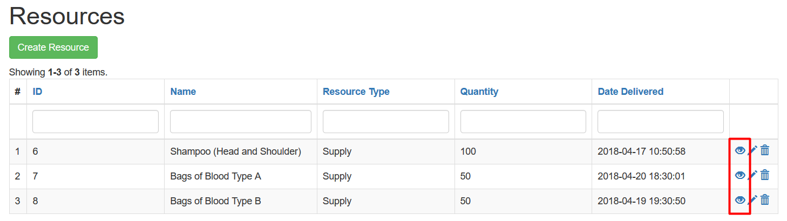
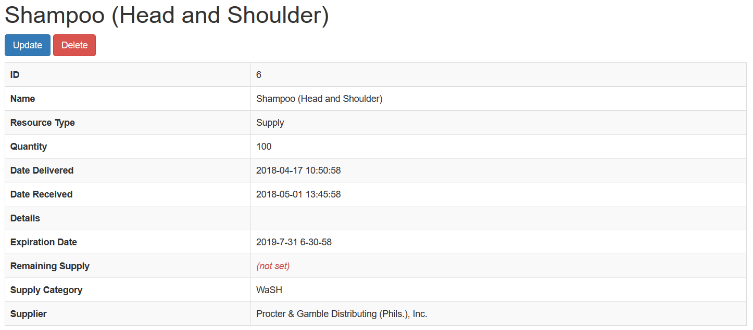
To view the resources, click the EYE icon on the rightmost column
Procurement
It will then show a much more detailed view of the selected resource
Logistics Cluster

Slide 17
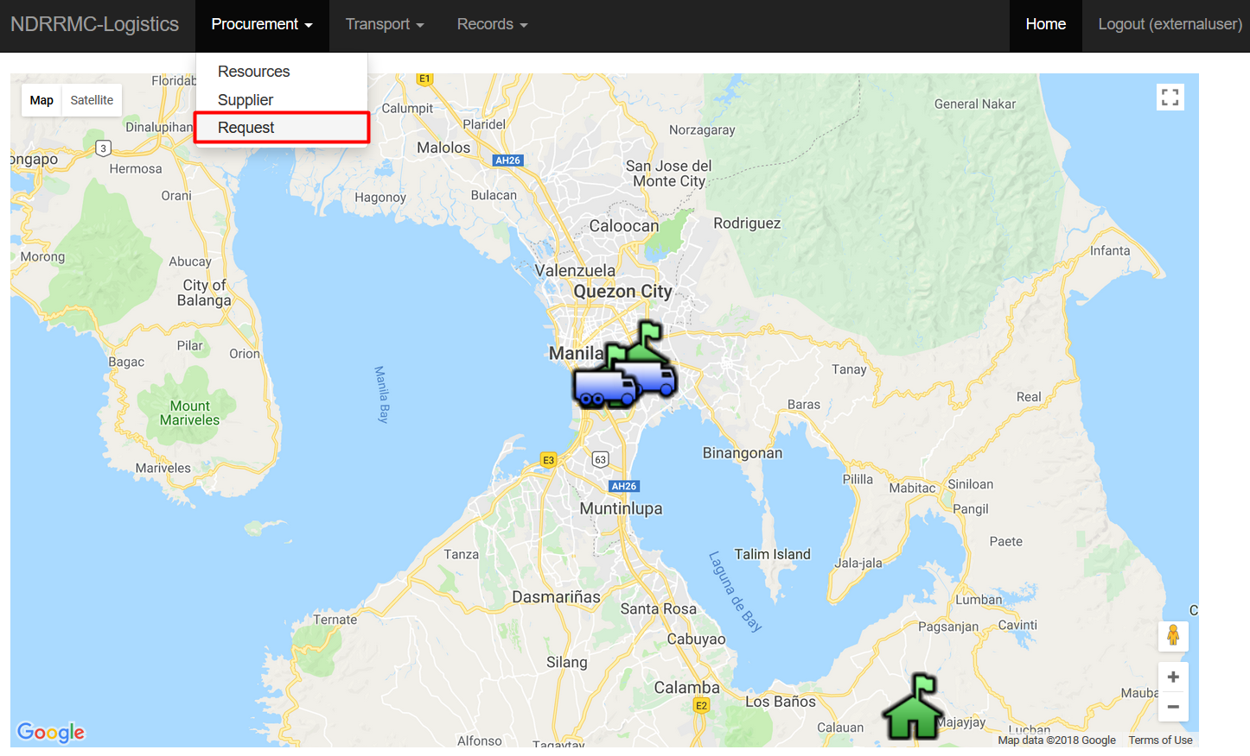
For creating Requests, go to the Procurement Tab, and choose Request
Procurement
Logistics Cluster

Slide 18
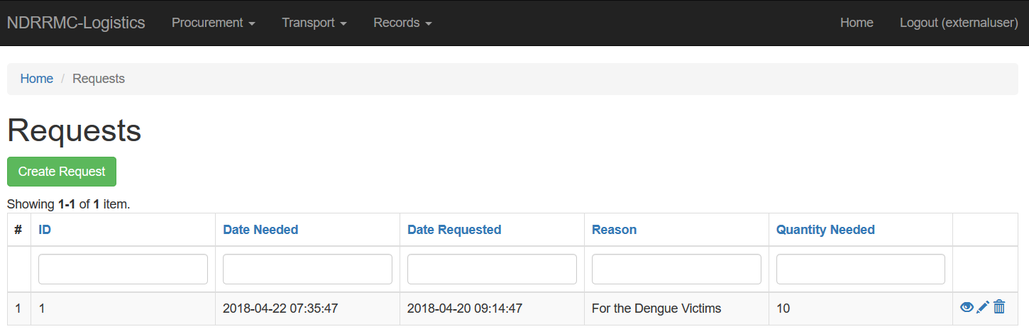
This will re-direct you to the Requests home page
Procurement
This will display all the recorded requests. The user has the option
Logistics Cluster
to CREATE, VIEW, UPDATE, and DELETE requests.

Slide 19
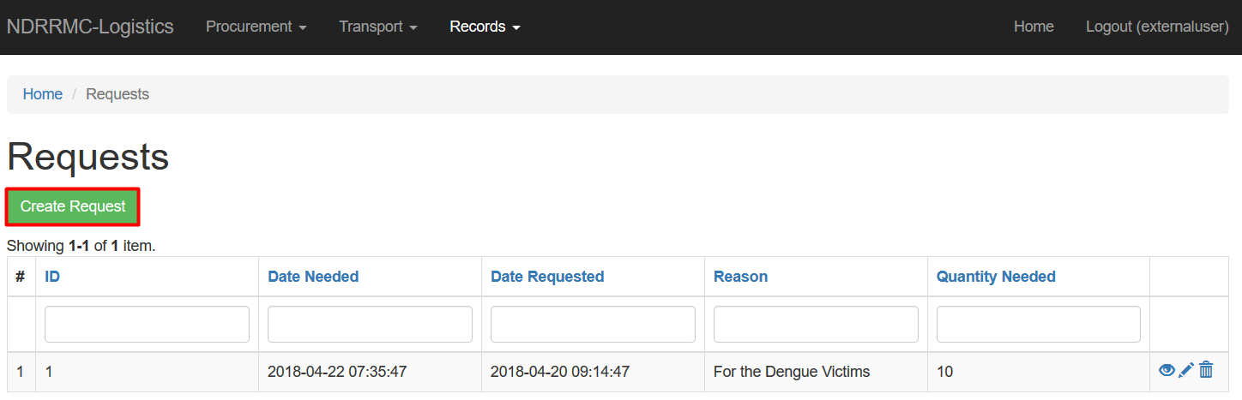
For creating requests, click the “Create Request” button.
Procurement
This will re-direct you to the web page to fill-in the required fields
Logistics Cluster
for creating a request.

Slide 20
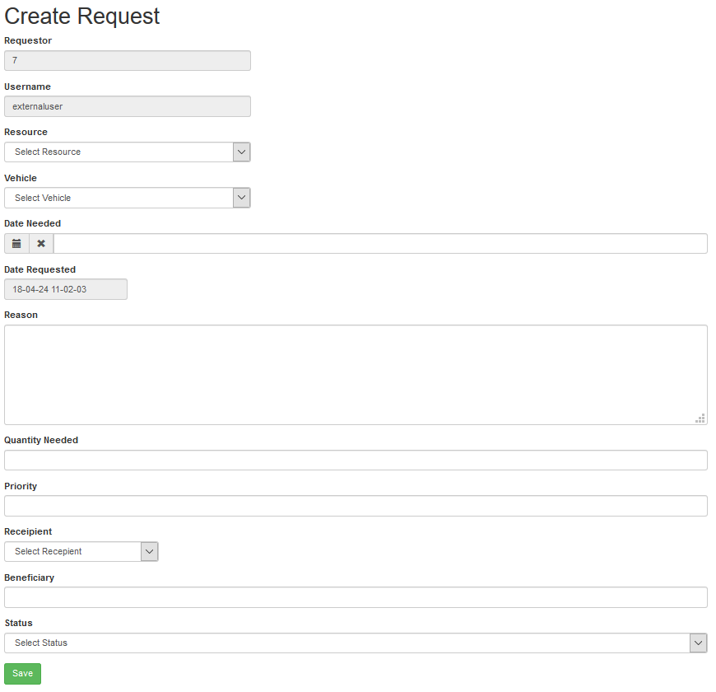
These are the fields the user has to fill-in to create a Request.
Procurement
Logistics Cluster

Slide 21
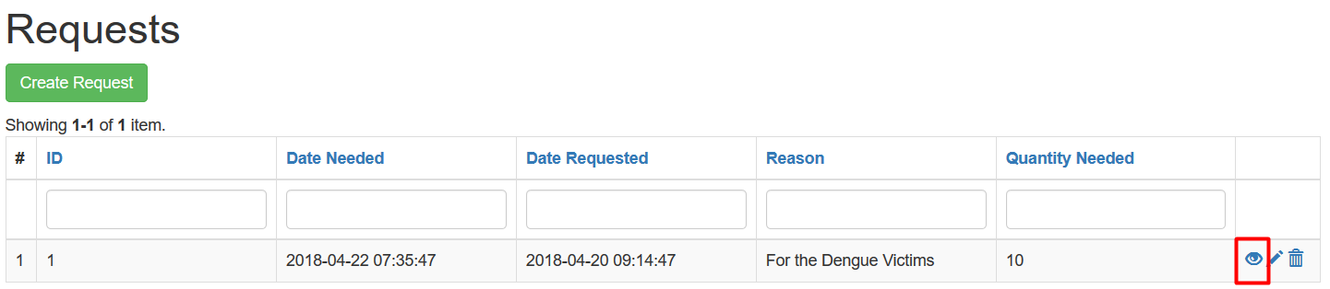
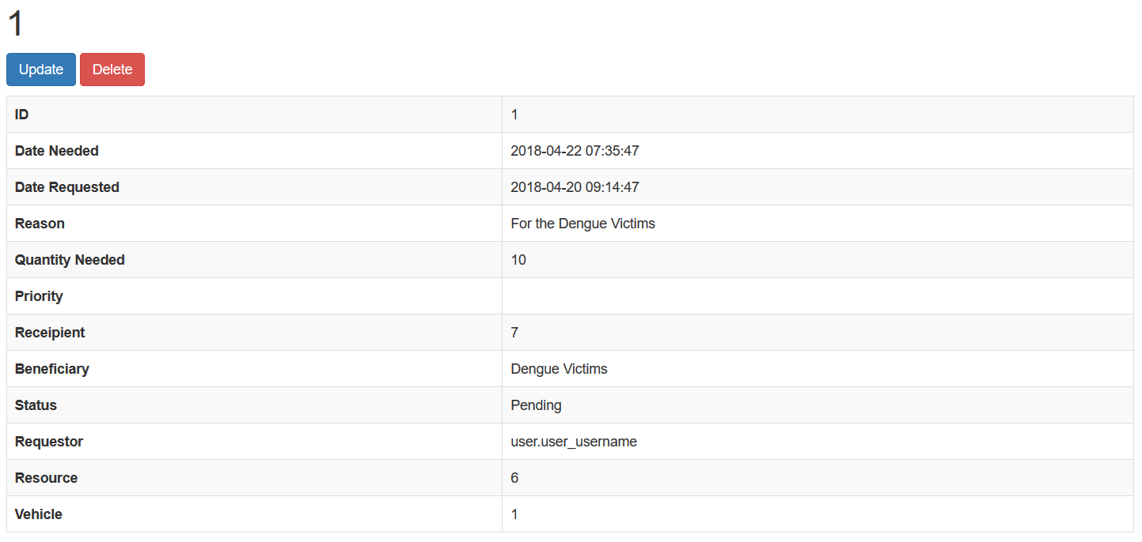
To view the requests, click the EYE icon on the rightmost column
Procurement
It will then show a much more detailed view of the selected request
Logistics Cluster

